Slide 1

RESIDENT MANAGEMENT
Version 1.4
Divya Bharathi S
Adhi Software Pvt Ltd
http://www.adhisoftware.co.in

Slide 2
Content
Admin
Account Management
Resident Management
Billing
Report
Configuration

Slide 3
Introduction
Used in Senior Living Homes, Nursing Homes, Vacation Homes, Retirement Homes, Hospitals and Hotels.
Features
    Move-in
    Move-Out
    Billing
    Payment
    Reports and Dashboards.
Built on top of Salesforce entities; Lead, Account and Contact

Slide 4
Flow Diagram
LEAD
Convert
Convert
ACCOUNT
RESIDENT
SERVICE
Assigned
Service
Move In
Assigned
Amenity
Pay
RESIDENT
AMENITY
RESIDENT
PAYMENT
Perform
Service
Generate
SERVING
EMPLOYEE
INVOICE

Slide 5
Admin
User profile should have “Administer RM Set Up” privilege can manage the RM Entities.
Property1
Room1
Bed A
Room2
Bed B
Organization
Property2
Room3
Property3

Slide 6
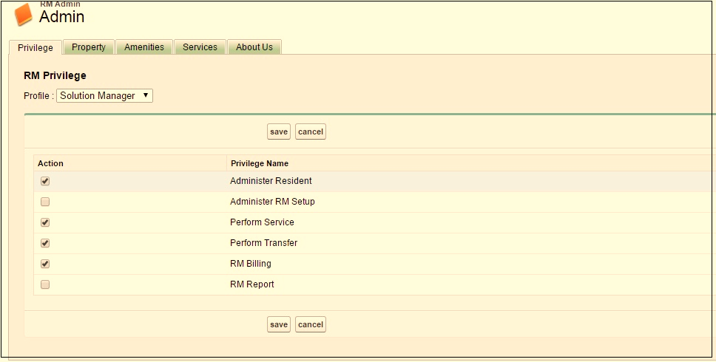
Privilege
“System Administrator” profile can manage the privilege.

Slide 7
Privilege(Contd..)
# | Privilege | Description
1 | Administer Resident | To Access RM Resident page
2 | Administer RM Setup | To Access RM Admin page
3 | Perform Service | To Access Perform Service page
4 | Perform Transfer | Performing Move-In, Transfer & Move Out
5 | RM Billing | To Access RM Billing page
6 | RM Report | To Access RM Report page

Slide 8
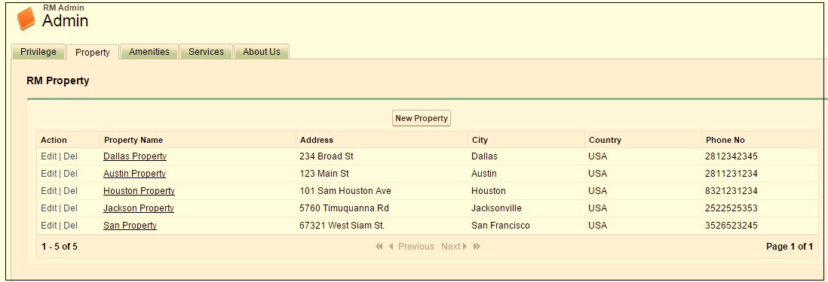
Property
Property is related to building which contain rooms and beds.

Slide 9
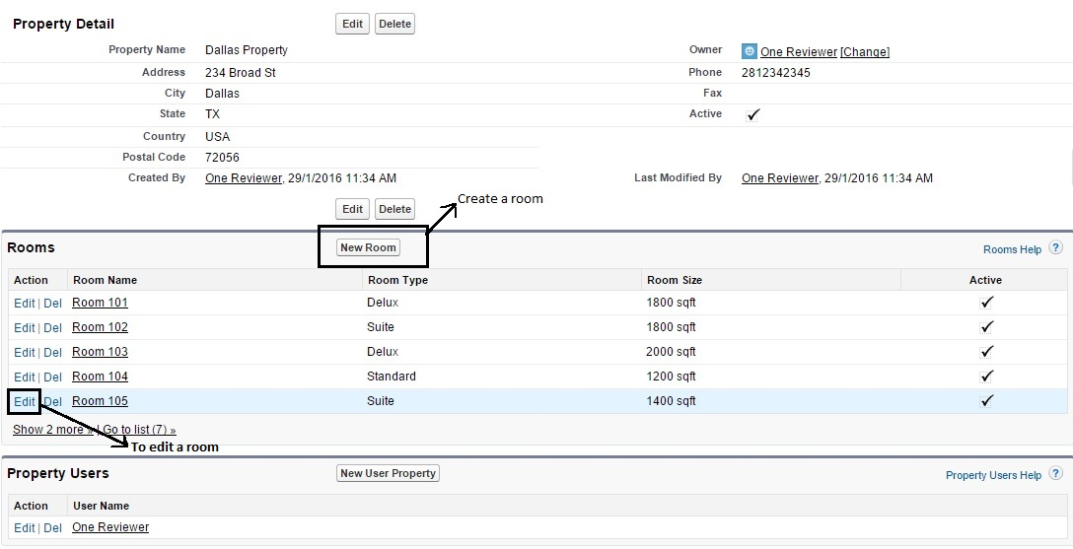
Property - Detail
It shows the property information, Rooms and Property Users.
Sharable room enabled on RM Settings, allows for multiple bed creation

Slide 10
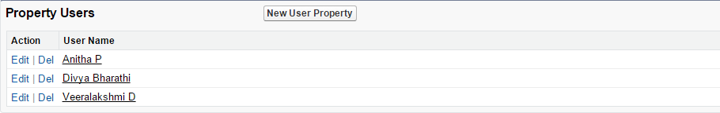
Property Users
Property Users are the employees of the property.

Slide 11
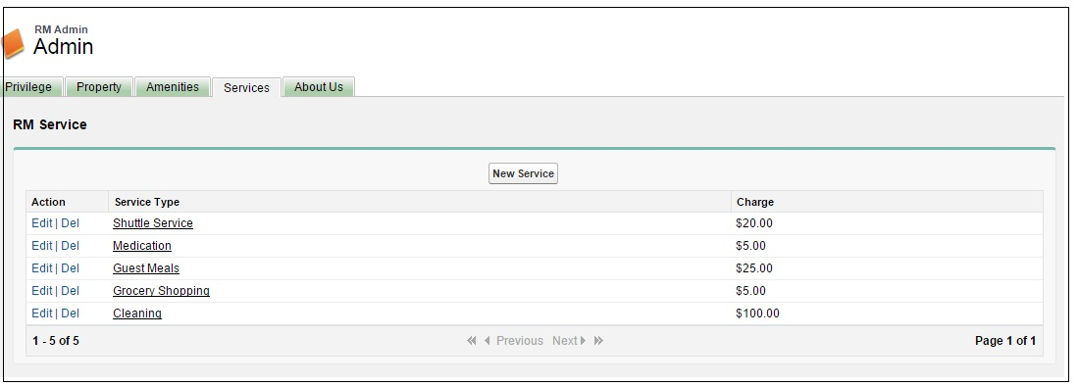
Services
Services are offerings provided by the property to Residents.
Services have a charge.

Slide 12
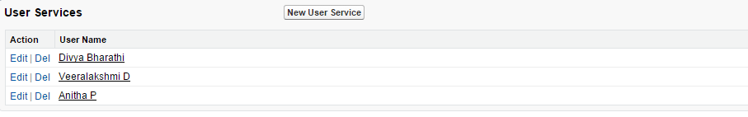
User Service
User Services are services performed by employees for the resident

Slide 13
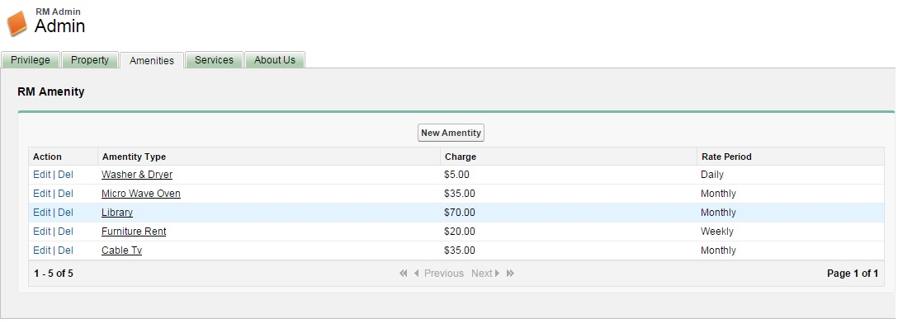
Amenities
Amenities provided by the property to the residents
Amenities have a charge and a rate frequency.

Slide 14
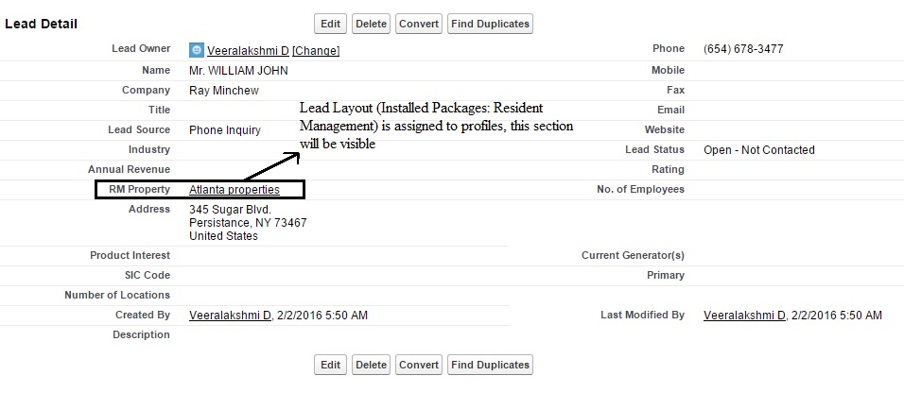
Account Management
Leads are collected in salesforce using their standard leads page.

Slide 15
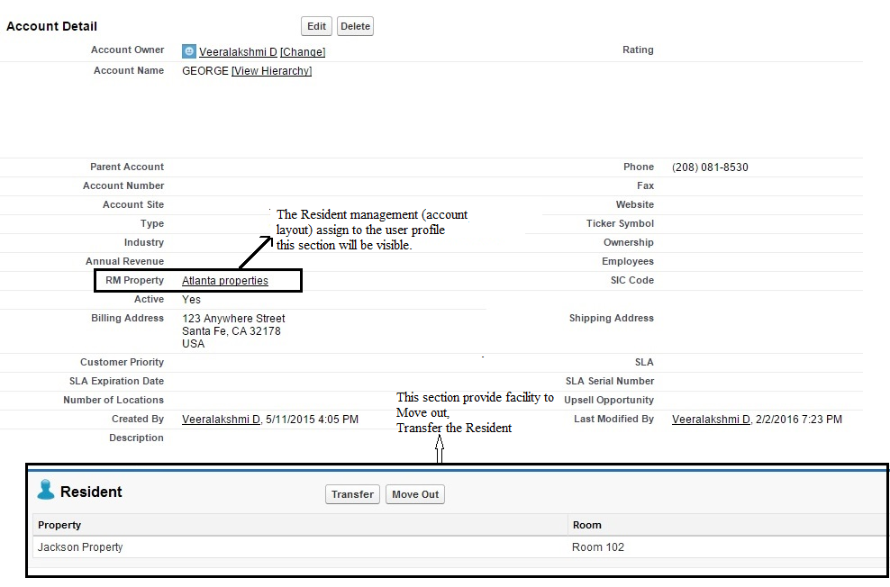
Account
Accounts are moved in to Room/Bed to become a resident.

Slide 16
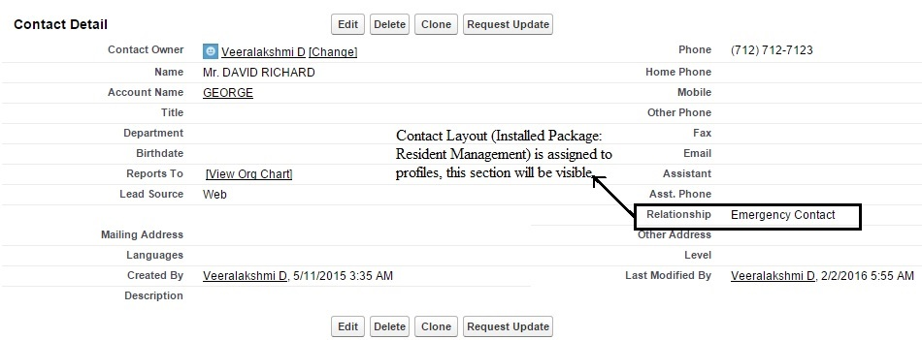
Contact
Contacts are people associated with the account.
Relationship field will be displayed in contact detail page.

Slide 17
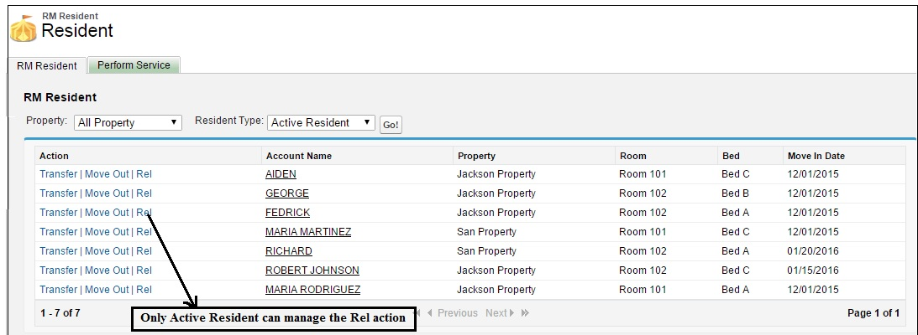
Resident Management
Profile should have “Administer Resident” or “Perform service” privilege.

Slide 18
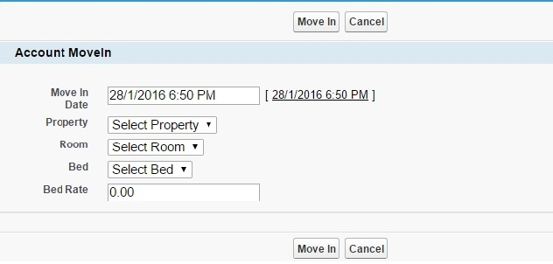
Move In
Profile should have “Perform Transfer” privilege can Move In Residents.

Slide 19
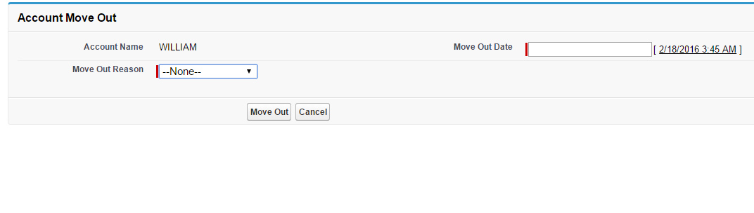
Move Out
Profile should have “Perform Transfer” privilege can manage Move Out action.

Slide 20
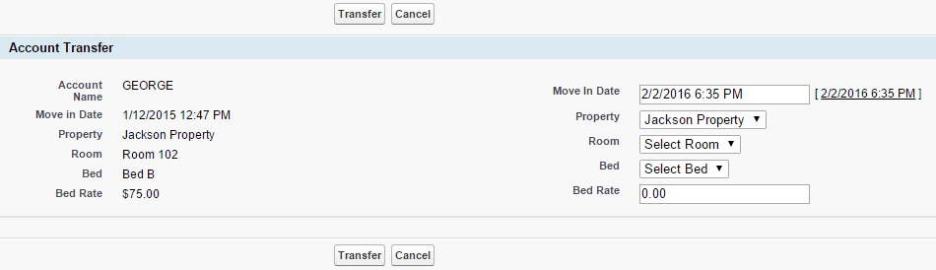
Transfer
Profile should have “Perform Transfer” privilege can manage the Transfer action.
Transfer of Resident is nothing but moving out from one room/bed and moving in to another room/bed.

Slide 21
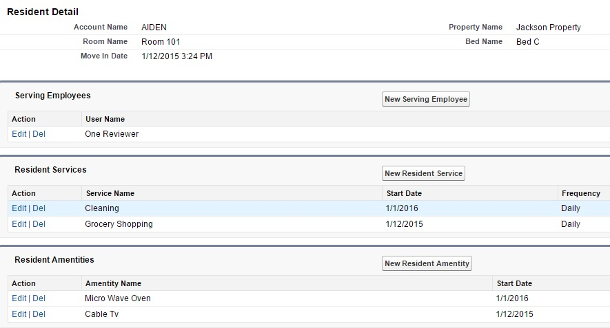
Resident Related Info
It show the related information of a resident like Serving Employee, Resident Services, and Resident Amenities.

Slide 22
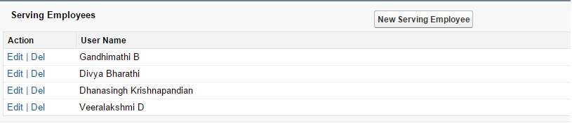
Serving Employee
An employee who manages all the activities of a resident, can be assigned

Slide 23
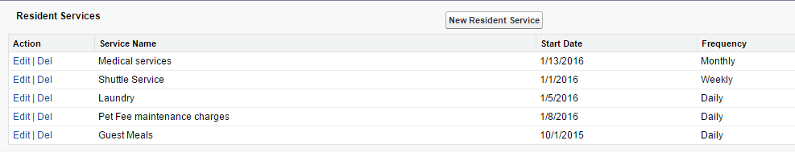
Resident Services
Services assigned to Residents, with a start date and frequency.

Slide 24
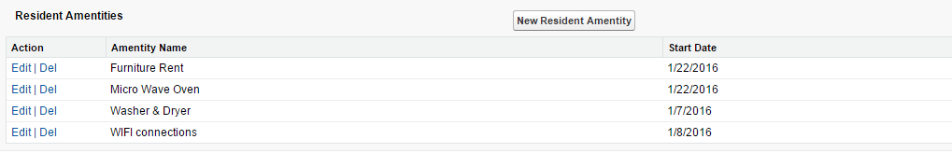
Resident Amenities
Amenities assigned to Residents, with a start date.

Slide 25
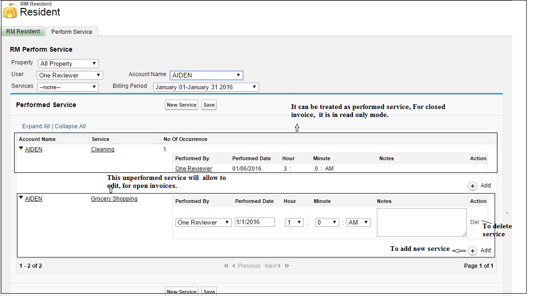
Perform Service
User profile should have “Perform Service” privilege .
Employees record the service performed on a Resident

Slide 26
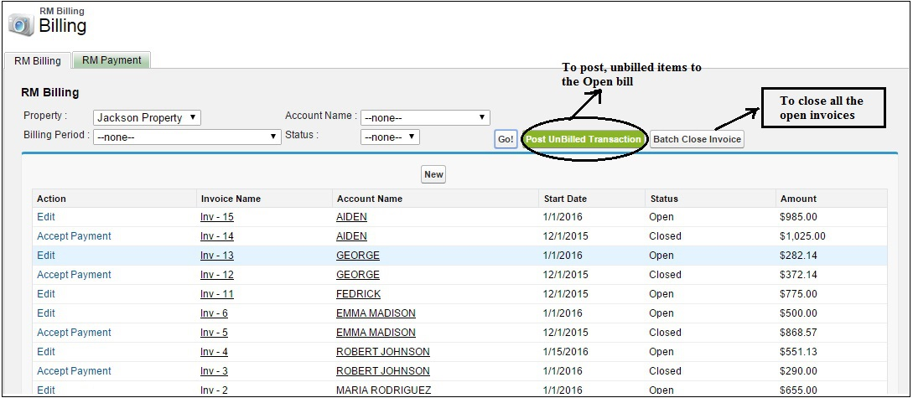
Billing
Profile should have “RM Billing” privilege.

Slide 27
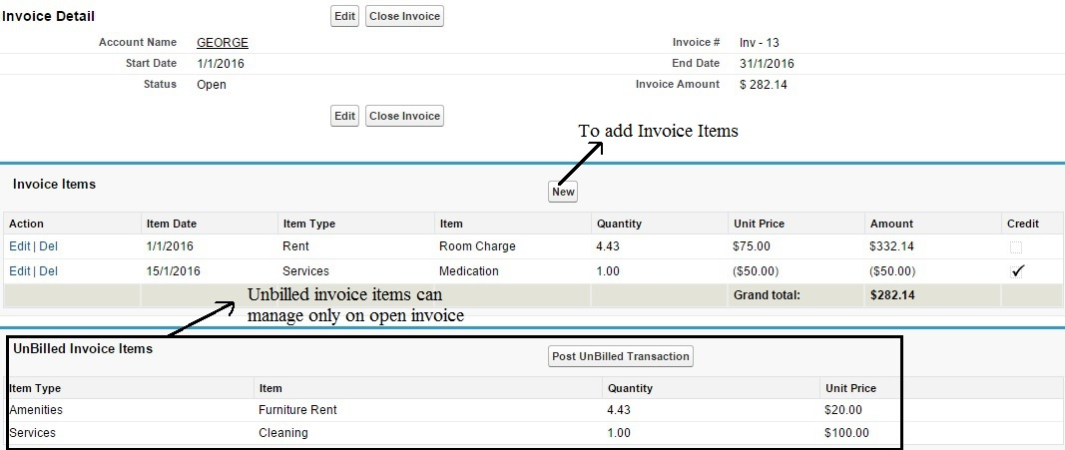
Open Invoice
It contains invoice detail, items and unbilled invoice items.

Slide 28
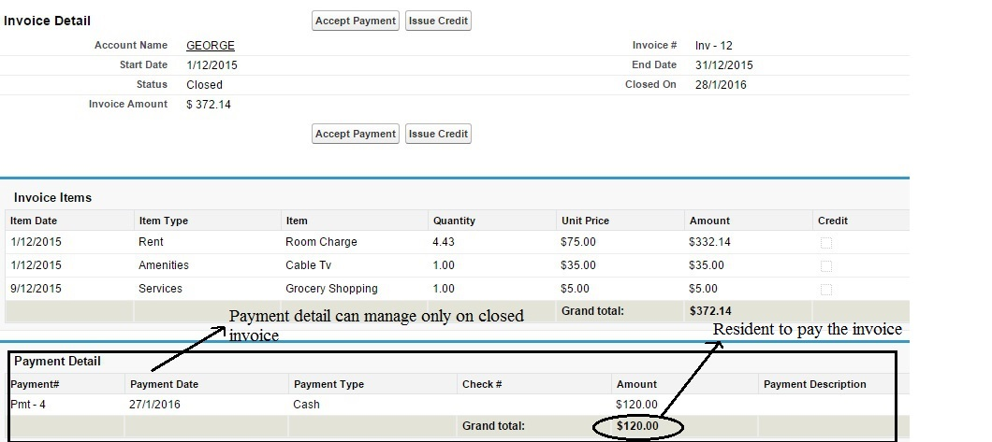
Close Invocie
Closed Invoices cannot be edited
Credit can be issued and will get applied on an open invoice.

Slide 29
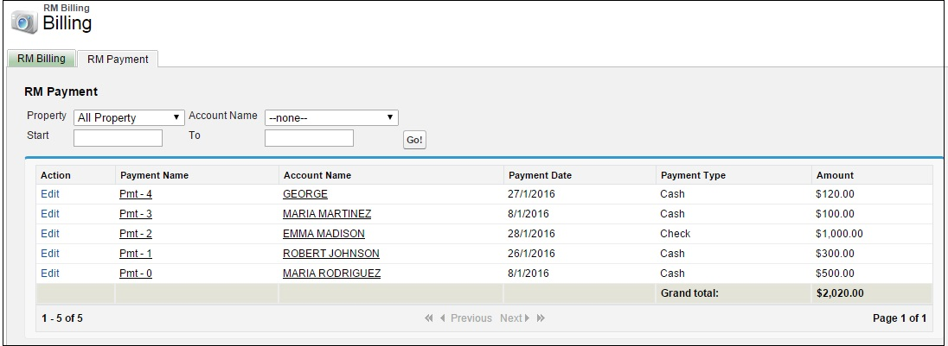
Payment
Payments are accepted against a closed invoice
“Administer RM Set up” privilege will allow for editing payments.

Slide 30
Reports
Move in Report
Move Out Report
Late Payment Report
Outstanding Payment Report
Invoice Statement
Task Sheet Report

Slide 31
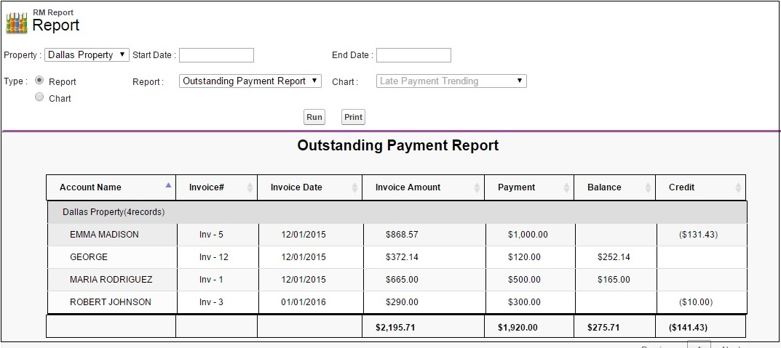
Report - Outstanding Payment
It shows the resident outstanding payment by month grouped by property

Slide 32
Chart
Late Payment Trending
Occupancy Trending
Outstanding Payment Trending

Slide 33
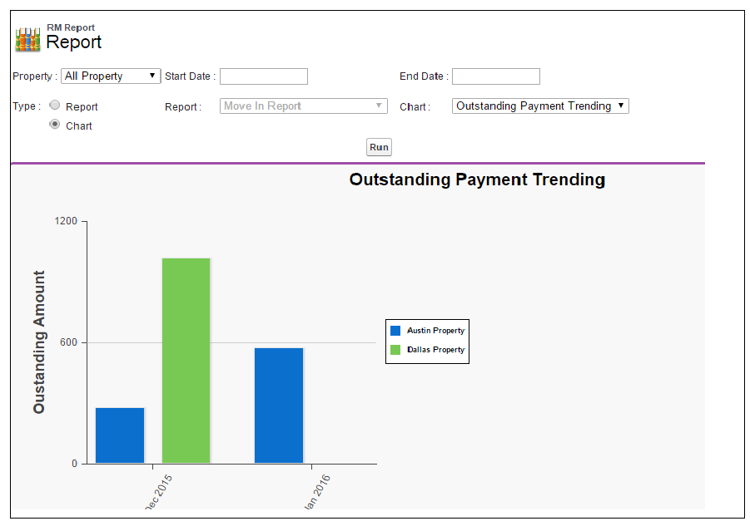
Chart - Outstanding Payment Trending
It shows the monthly outstanding payment count in bar graph.

Slide 34
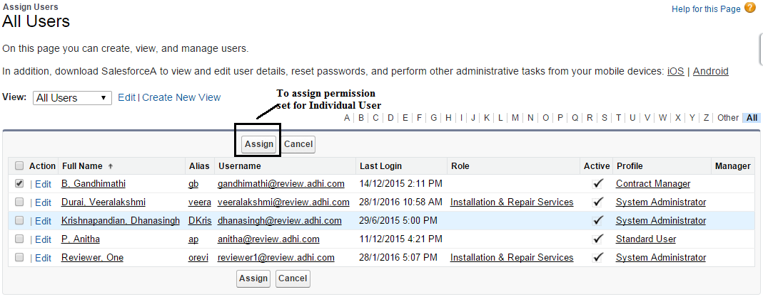
Configure – Permission Set
Permission Set Assignment

Slide 35
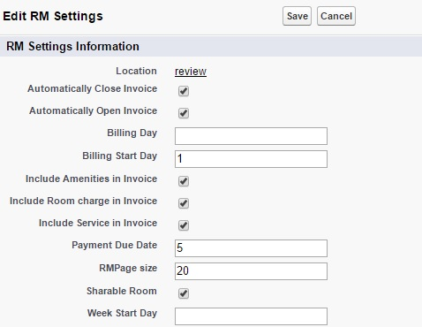
Configure RM Settings
Admin user can configure the RM Settings.

Slide 36
Page Layout Assignment
For Enterprise Edition or above, the custom page layouts can be used.
  Lead Layout(Installed Packages: Resident Management)
  Account Layout(Installed Packages: Resident Management)
  Contact Layout(Installed Packages: Resident Management)

Slide 37
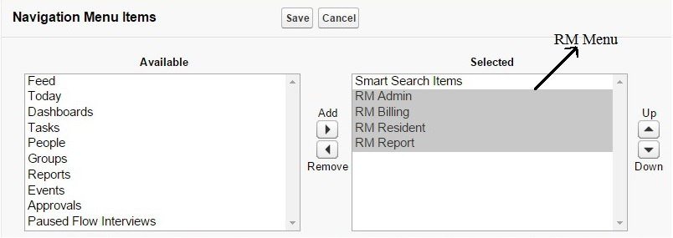
Mobile Setup
Users can access the Resident Management App on mobile devices
  Download Salesforce1 App in mobile.
    Go to (Set up → Administration Setup → Mobile Administration → Salesforce1 Navigation).

Slide 38
Contact Us
Adhi Software Pvt Ltd
http://www.adhisoftware.co.in
info@adhisoftware.co.in
+1 732 661 8294
+91 44 27470401
+91 44 27470402
+91 44 27470403

